Slide 1
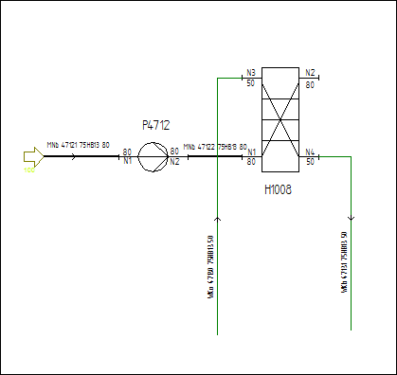
E11V01 – Heat Exchanger with Equipment Bar, Chambers
PlateAndShellHeatExchanger
2 Chambers
Engineering Data:
TagName H1201, including prefix, line number, suffix
all data from equipment bar
H1101
Ident | H1101
Design Press. min. Chamber 1 / 2 | -1 barg | -1 barg
Design Press. max. Chamber 1 / 2 | 60 barg | 30 barg
Design Temp. min. Chamber 1 / 2 | -45 °C | -45 °C
Design Temp. max. Chamber 1 / 2 | 100 °C | 100 °C
Design Duty / Design Heat Transfer Area | 313 kW | 46,8 m²
Plate Height / Plate Width | 850 mm | 1100 mm

